Slide 1


Image Feature Extraction: Morphology & Dynamics (Shape & Moment)
Tom Zimmerman
IBM Research-Almaden
Sept 14, 2020
This material is based upon work supported by the NSF under Grant No. DBI-1548297.
Disclaimer: Any opinions, findings and conclusions or recommendations expressed in this material are those of the authors and do not necessarily reflect the views of the National Science Foundation.

Slide 2
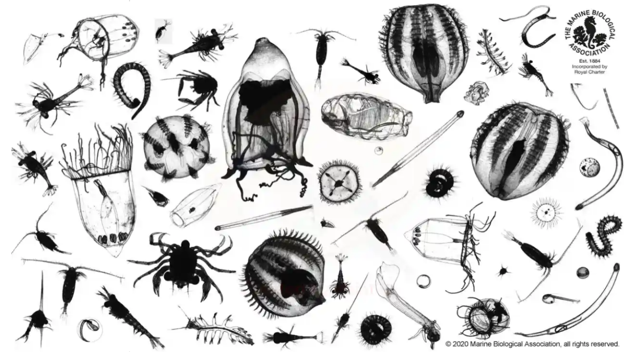

Slide 3
All images are displayed at the same scale. (a) Didinum (b) Paramecium (c) Blepharisma (d) Euplotes
(e) Algae1 (f) Algae2 (g) Volvox (h) Dileptus (i) Stentor

Slide 4
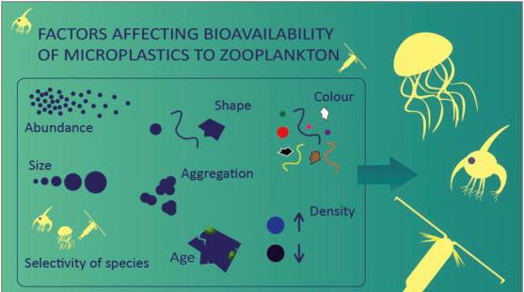
https://doi.org/10.1016/j.envpol.2018.10.065

Slide 5
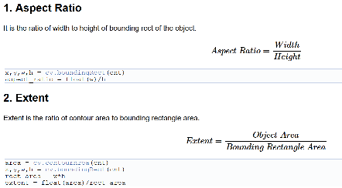
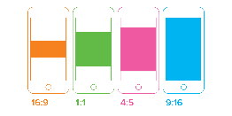
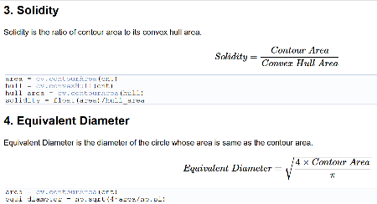
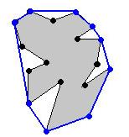

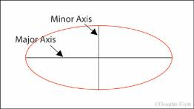


Contour Properties
Display
Aspect Ratio
1920/1080=1.78
640/480=1.34
How much fills out the rectangle bounding box
Extent=Yellow Area/Rectangle Area
How much fills out the convex bounding hull
Solidity=Gray Area/Blue Bounded Area
area=pi*d²/4
d
Can also look at R/G, B/G
https://docs.opencv.org/master/d1/d32/tutorial_py_contour_properties.html

Slide 6
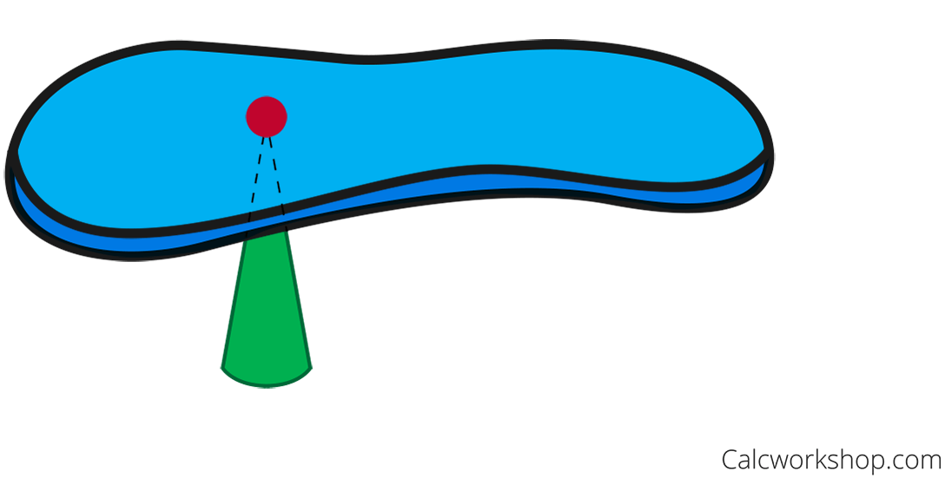
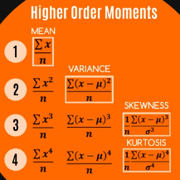
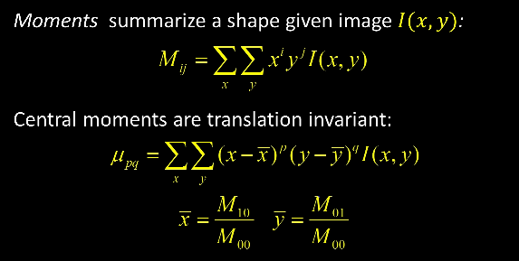
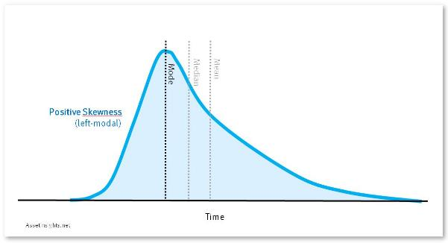
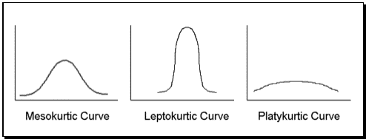
Image Moments:
Distribution of brightness (intensity)
Weighted average of the image pixels' intensities
zero^{th} moment=total mass
center mass=1st moment/mass
2^{ed} moment= rotational inertia
RAW
mean=average
median=middle between population
mode=most frequent value
variance=how spread out
skew=symmetry of distribution tail
kurtosis= peaking in distribution
CENTRAL
center of mass
mean intensity
translation invariant
k=3
k>3
k<3
https://youtu.be/AAbUfZD_09s
zero^{th} moment i=j=0
M₀₀=sum of all pixel brightness
for binary image, M₀₀=area, counting non-zero pixels
x= M₁₀ (sum of all x intensity) divided by (M₀₀) number of pixels
***WATCH=>What are "moments" in statistics? An intuitive video! https://www.youtube.com/watch?v=ISaVvSO_3Sg

Slide 7
minAreaBound
h
w

Slide 8
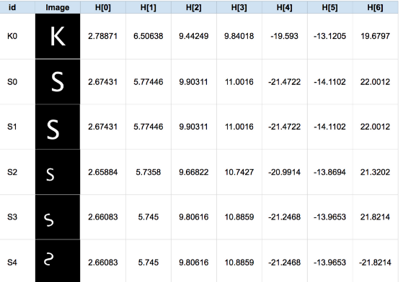
Hu Moments:
Set of 7 numbers calculated using central moments that are invariant to image transformations of translation, scale, and rotation, and reflection.
moments = cv2.moments(myIM) # Calculate Moments of image myIM
huMoments = cv2.HuMoments(moments) # Calculate Hu Moments
for i in range(0,7): # Convert to log
huMoments[i] = -1* copysign(1.0, huMoments[i]) * log10(abs(huMoments[i])))
Hu Moments (linear)
Hu Moments (log)
h[0] = 0.00162663 h[1] = 3.11619e-07 h[2] = 3.61005e-10 h[3] = 1.44485e-10 h[4] = -2.55279e-20 h[5] = -7.57625e-14 h[6] = 2.09098e-20
H[0] = 2.78871 H[1] = 6.50638 H[2] = 9.44249 H[3] = 9.84018 H[4] = -19.593 H[5] = -13.1205 H[6] = 19.6797
https://www.learnopencv.com/shape-matching-using-hu-moments-c-python/

Slide 9
Pastore, et. al, Annotation-free Learning of Plankton for Classification and Anomaly Detection

Slide 10
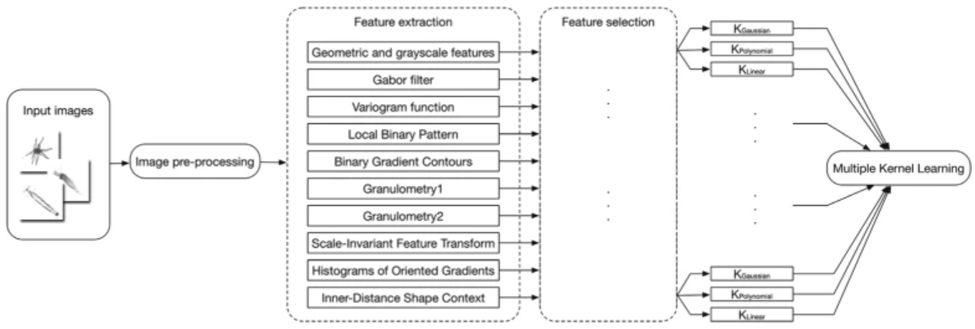
Automatic plankton image classification combining multiple view features via multiple kernel learning
Zheng, H., Wang, R., Yu, Z. et al. Automatic plankton image classification combining multiple view features via multiple kernel learning. BMC Bioinformatics 18, 570 (2017). https://doi.org/10.1186/s12859-017-1954-8

Slide 11
Gabor filters with 6 kinds of frequencies and 8 kinds of orientations for plankton texture
Rotation
Linear filter used for texture analysis.
Analyzes whether there is any specific frequency content in the image in specific directions in a localized region around the point or region of analysis.
-Wikipedia
Lower
Freq.
Zheng, H., Wang, R., Yu, Z. et al. Automatic plankton image classification combining multiple view features via multiple kernel learning. BMC Bioinformatics 18, 570 (2017). https://doi.org/10.1186/s12859-017-1954-8

Slide 12
Geometric
area
aspect ratio
texture (sum of Canny edge pixels divided by area)
contour smoothness (contour pixels divided by square root of area).

Slide 13
100%
83%
time/effort

